Slide 1
Mojaloop Performance Workstream
End of PI-27 Report

Slide 2
Workstream Update
Workstream Name: | Mojaloop Performance
Roadmap Pillar: | Foundation: Quality Product
Lead: | James Bush
Workstream Objectives: | To characterise, understand and publish the factors impacting performance of the Mojaloop open-source software for the purposes of: Enhancing efficiency of the Mojaloop platform Enabling adopters to make informed decisions about infrastructure typically required to achieve specific performance targets.
Progress Against Objectives: | Production of white paper in progress Performance testing regime defined and underway
Anticipated Progress by PI End: | As above.
Roadblocks: | Contributor time: Performance testing is time consuming
Support Needed: | Test Engineers with Mojaloop experience

Slide 3
Progress Since Last Report
Several performance test runs carried out by various contributors.
A white paper is currently being produced
Covers a number of performance testing activities carried out by MLF and community members during the PI, under various deployment scenarios and scheme architectures
Publication expected in Q3 2025
Test Plan: https://docs.google.com/document/d/1rUdugAXPXAxMNSYNYiyH5hy01QqWe0qnqlffiDzbgBg/edit?usp=sharing
Test Matrix: https://docs.google.com/spreadsheets/d/1lT1SYvtESqHRKsy32sCOUJ5z_x6Ne8Ep-nzbITH5fpM/edit?usp=sharing
Grateful thanks to AWS for donating cloud credits for MLF testing activities.
Grateful thanks to Abli Pay for their valuable contributions to performance testing.
Grateful thanks to Infitx for their valuable contributions to performance testing.

Slide 4
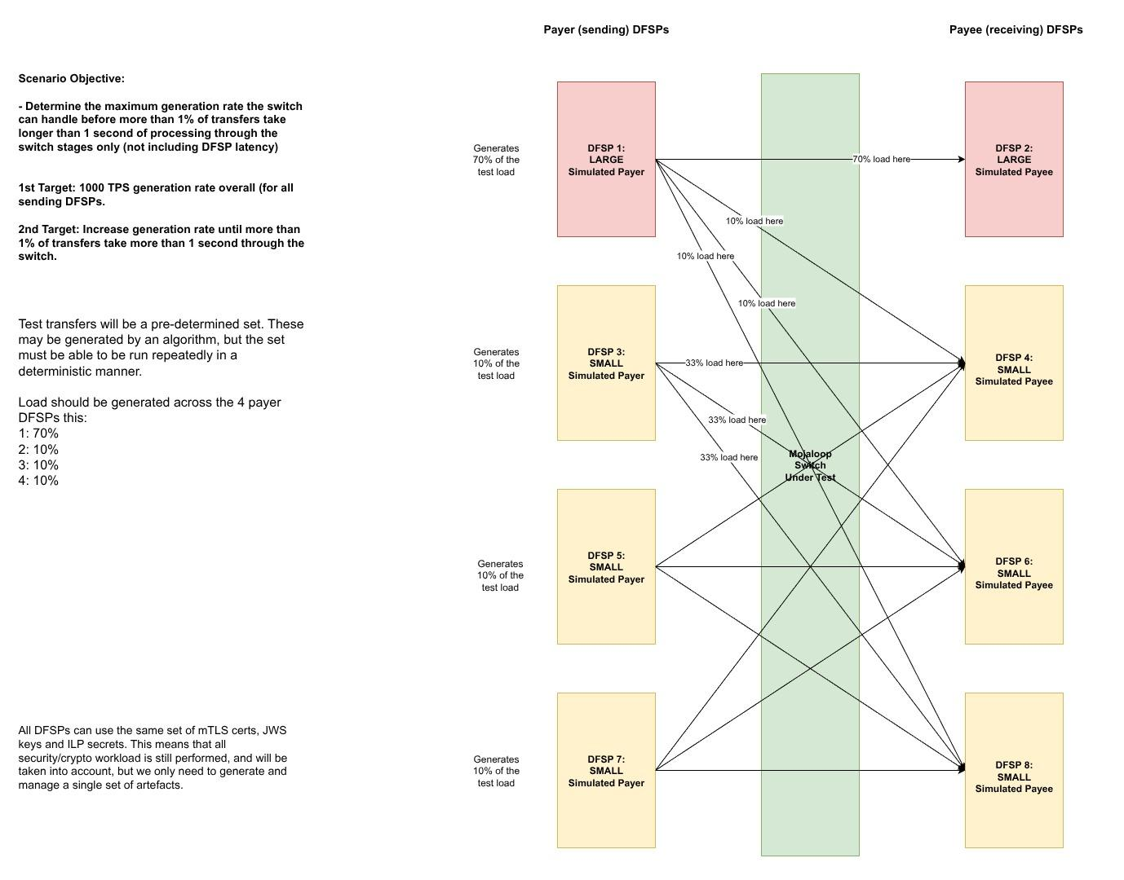

Slide 5
Objectives for PI-28
Complete performance testing activities:
Cloud
On-Premises (MLF test lab)
Complete publication of white paper.
Target is Q3 2025

Slide 6
Objectives beyond PI-28
P1: Introduce end-to-end performance testing into the official Mojaloop release process
Publish performance data with every official release.
P2: Introduce performance testing in continuous integration
Target performance critical components initially
Expand to all components as resources and contributions permit

Slide 7
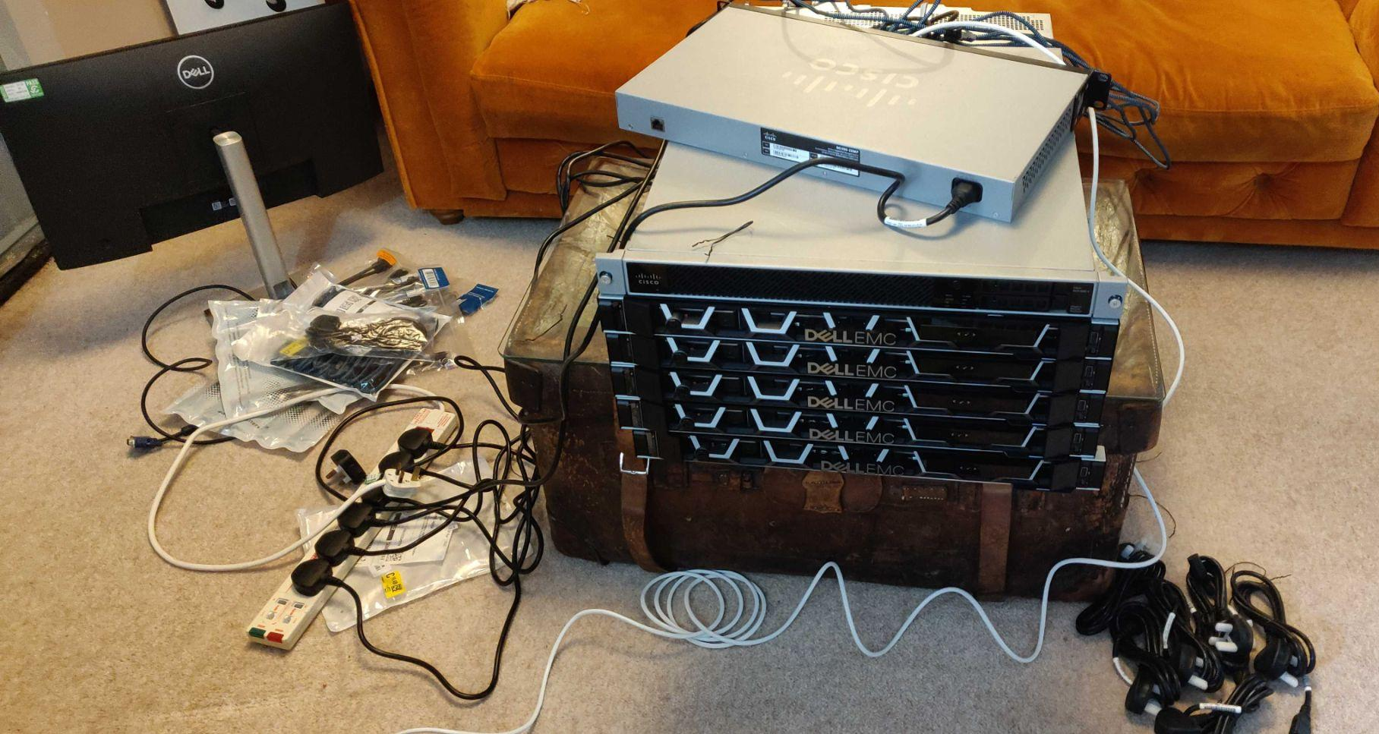

MLF Test Lab
Under construction…

Slide 8

Joining the workstream
Mojaloop Slack: #ws-performance
Weekly meeting (zoom) on Mondays @ 1500 UTC
Workstream Notes: https://docs.google.com/document/d/1-_-4N_6BFEWDjr4ODIYvID3RUABw1e3wmk6ZlpYTs48/edit?usp=sharing

